Slide 1
Static Variables
Documented Code
Minified Code

Slide 2
Static Variables
Also known as “class variables” or “shared variables”.
Declare a variable using the “static” keyword.
Variables do not exist in instance objects.
Variables exist on the class.
You don’t need objects to be instantiated for the class to exist.
The class exists as needed once it is defined.

Slide 3
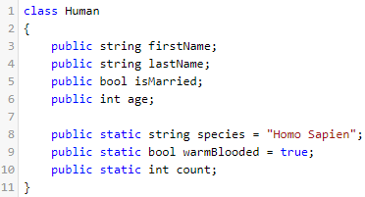
Class “Human”
Define Class
Member Variables
firstName
lastName
isMarried
age
Static Variables
species
warmBlooded
count
“Homo Sapien”
true

Slide 4

Class “Human”
Define Class
Create Instance Object
Member Variables
firstName
lastName
isMarried
age
Static Variables
species
warmBlooded
count
“Homo Sapien”
true
p1
firstName
“Donnie”
lastName
“Wahlberg”
true
isMarried
age
52

Slide 5

Class “Human”
Define Class
Create Instance Object
Create Instance Object
Member Variables
firstName
lastName
isMarried
age
Static Variables
species
warmBlooded
count
“Homo Sapien”
true
p1
p2
firstName
“Donnie”
firstName
“Donnie”
lastName
“Wahlberg”
lastName
“Santos”
true
false
isMarried
isMarried
age
52
age
43

Slide 6
Class “Human”
Define Class
Create Instance Object
Create Instance Object
Set Static Variable Value
Member Variables
firstName
lastName
isMarried
age
Static Variables
species
warmBlooded
count
“Homo Sapien”
true
2
p1
p2
firstName
“Donnie”
firstName
“Donnie”
lastName
“Wahlberg”
lastName
“Santos”
true
false
isMarried
isMarried
age
52
age
43

Slide 7
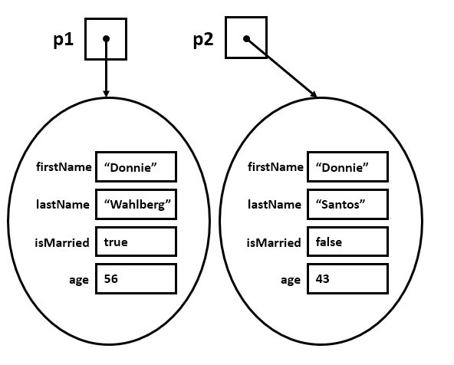
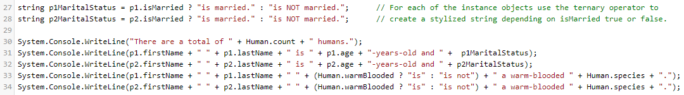
Class “Human”
Member Variables
firstName
lastName
isMarried
age
Static Variables
species
warmBlooded
count
“Homo Sapien”
true
2

